Slide 1
C++ Style Guide
Taras Lushney, Andriy Korkuna 10th April 2016,

Slide 2
Agenda
Keys ideas
Layout
Naming
Formatting
Comments

Slide 3
Keys ideas
Code should be written to minimize the time it would take for someone else to understand it.

Slide 4
Layout
Header Files
Source Files

Slide 5
Header Files
Following is the template that should be used to organize class declaration in .h file:
All header files should have "#pragma once" guard to prevent multiple inclusion.
Order your includes in header file as follows:
System files.
Other 3-rd party libraries' .h files.
Your project's .h files.
Avoid using forward declarations where possible. Just #include the headers you need.
Namespaces wrap the entire header file after includes and forward declarations of classes from other namespaces.
Define functions inline only when they are small (10 lines or less).

Slide 6
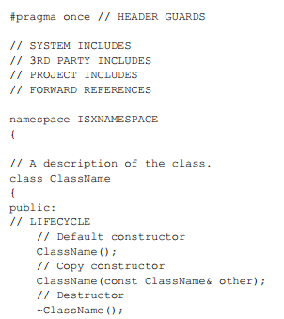
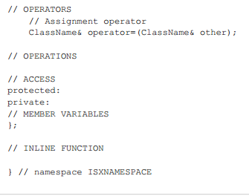

Slide 7
Source Files
Following is the template that should be used to organize class declaration in .h file:
All header files should have "#pragma once" guard to prevent multiple inclusion.
Order your includes in source file as follows:
Precompiled header "StdAfx.h"
Corresponding header file.
System files.
Other 3-rd party libraries' .h files.
Your project's .h files.
Avoid using forward declarations where possible. Just #include the headers you need.
Namespaces wrap the entire source file after includes and forward declarations of classes from other namespaces.
Define functions inline only when they are small, say, 10 lines or less.

Slide 8
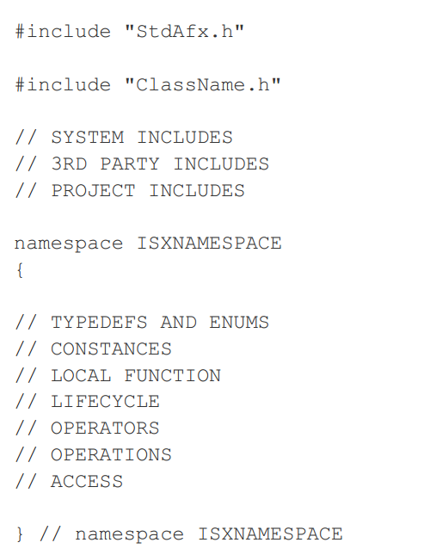

Slide 9
Naming
File Names
Type Names
Function Names
Namespace Names
Enumerator Names
Macro Names
Exceptions to Naming Rules

Slide 10
File Names
File name starts with a capital letter and have a capital letter for each new word, with no underscores.
C++ files should end in .cpp and header files should end in .h.
In general, every .cpp file should have an associated .h file.
UserCredentials.h
UserCredentials.cpp

Slide 11
Type Names
Variable Names
Common Variable names
Class Data Members
Struct Data Members
Global Variables
Constant Names

Slide 12
Type Names
The names of all types — classes, structs, typedefs, and enums — have the same naming convention.
Type names should start with a capital letter and have a capital letter for each new word. No underscores.
Do not use prefixes like capital "C" (for "class") of "T" or "Type" (for "types"). Do not use suffix "_t" for type names.
Interfaces classes are named like ordinary classes and should be prefixed with "I".

Slide 13
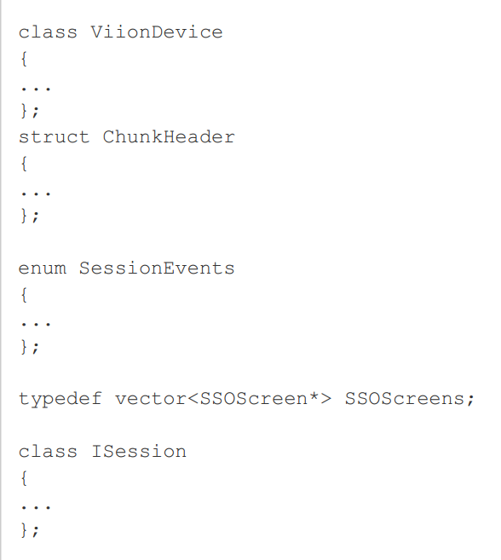

Slide 14
Variable Names
The names of variables and data members are all lowercase, with underscores between words.
Do not use Hungarian notation.
Consider adding the principal class name to the variable name, like "cancel_button"
Do not use class/category name based prefixes, like "btnCancel"
Do not use special notation for pointers or references, p_state, r_state
Avoid generic names, like tmp and retval.
Prefer min and max for limits.
Add words like is, has, can, or should for booleans.

Slide 15

Common Variable names

Slide 16
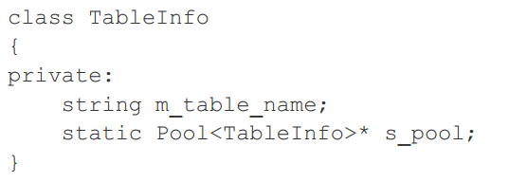
Class Data Members
Non-static data members of classes are named like ordinary nonmember variables and should be prefixed with "m_".
Static data members of classes are named like ordinary nonmember variables and should be prefixed with "s_".

Slide 17
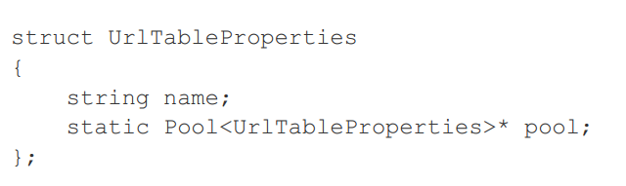
Struct Data Members
Data members of structs, both static and non-static, are named like ordinary nonmember variables.

Slide 18

Global Variables
For global variables, which should be rare in any case, but if you use one, consider prefixing it with "g_" to easily distinguish it from local variables.

Slide 19

Constant Names
Constants defined globally or within a class should be named with all capitals and underscores.

Slide 20
Function Names
Regular Functions
Accessors and Mutators

Slide 21
Regular Functions
Functions should start with a capital letter and have a capital letter for each new word. No underscores.

Slide 22
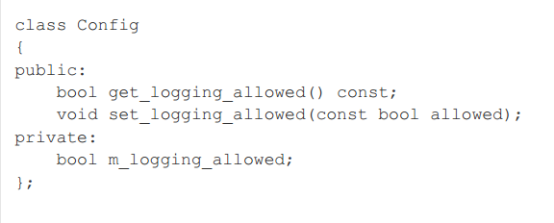
Accessors and Mutators
Accessors and mutators (get and set functions) should match the name of the variable they are getting and setting. The getter should be prefixed with "get_" and setter with "set_"

Slide 23
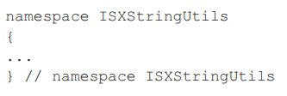
Namespace Names
Namespace names should start with a capital letter and have a capital letter for each new word. Historically it starts with ISX prefix.

Slide 24
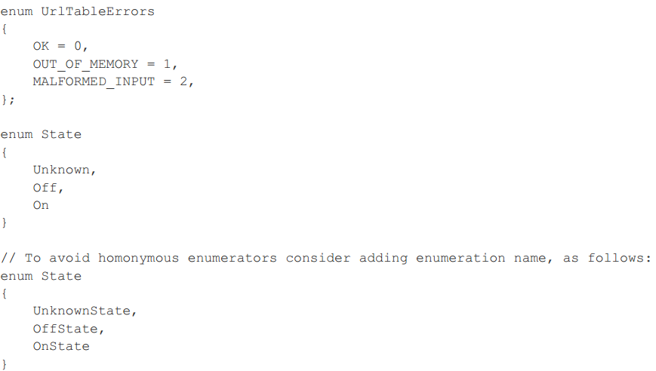
Enumerator Names
Enumerators should be named either like constants or use pascal case

Slide 25
Macro Names
In general macros should not be used. However, if they are absolutely needed, then they should be named with all capitals and underscores.

Slide 26
Exceptions to Naming Rules
If you are naming something that is analogous to an existing C or C++ entity then you can follow the existing naming convention scheme.

Slide 27
Formatting
Line Length
Spaces vs Tabs
Function Declarations and Definitions
Lambda Expressions
Conditionals and Loops
Pointer and Reference Expressions
Boolean Expressions
Return Values
Namespace Formatting
Preprocessor Directives
Class Format
Constructor Initializer Lists
Horizontal Whitespace
Vertical Whitespace

Slide 28
Line Length
Modern equipment has wide screens that can easily show longer lines. A line should fit to screen.

Slide 29
Spaces vs Tabs
Use only tabs.

Slide 30
Function Declarations and Definitions
Return type on the same line as function name, parameters on the same line if they fit.
If you cannot fit the return type and the function name on a single line, break between them.
The open curly brace is at new line.
There is never a space between the function name and the open parenthesis.
There is never a space between the parentheses and the parameters.
When defining a function, parameter order is: inputs, then outputs.
Use :: for global functions

Slide 31
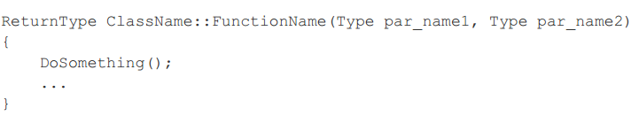
Function Declarations and Definitions
Names recommendations:
Avoid unneeded negation. Be positive. Prefer names as IsDone() to names as IsNotDone().
Use words in the normal language order
Functions look like this:

Slide 32
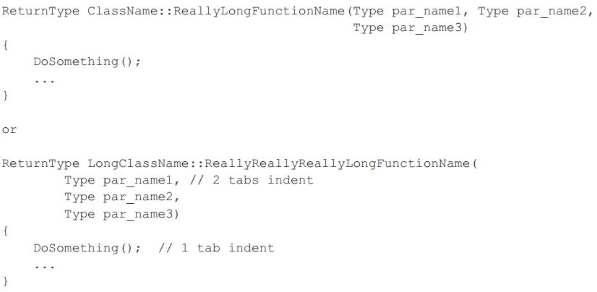
Function Declarations and Definitions
If you have too much text to fit on one line:

Slide 33
Lambda Expressions Conditionals and Loops
Prefer no spaces inside parentheses.
A space between the if and the open parenthesis.
The open curly brace is at new line.
Short conditional statements may be written on one line if this enhances readability.
In general, curly braces are not required for single-line statements. However, if one part of an if-else statement uses curly braces, the other part must too.

Slide 34
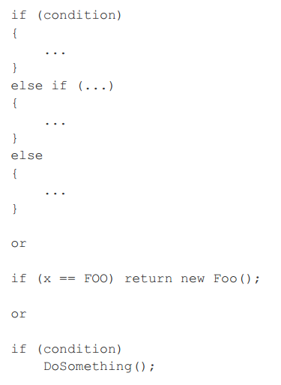

Slide 35
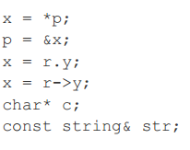
Pointer and Reference Expressions
No spaces around period or arrow.
Pointer operators have no space after the * or &.
Prefer place the asterisk adjacent to the type.

Slide 36
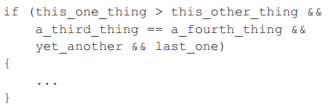
Boolean Expressions
If boolean expression is too long, be consistent in how you break up the lines.

Slide 37

Return Values
Do not needlessly surround the return expression with parentheses.

Slide 38
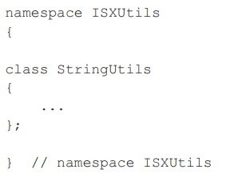
Namespace Formatting
The contents of namespaces are not indented

Slide 39

Preprocessor Directives
The hash mark that starts a preprocessor directive should always be at the beginning of the line.

Slide 40
Class Format
Any base class name should be on the same line as the subclass name, subject to the column limit.
The open curly brace is at new line.
The public:, protected:, and private: keywords should not be indented.
Do not leave a blank line after these keywords.
The public section should be first, followed by the protected and finally the private section.
It allowed to have few "public", "protected" and "private" sections.
Within each section, the declarations should be in the following order:
Typedefs and Enums
Constants (static const data members)
Constructors
Destructor
Operators
Methods, including static methods
Data Members (except static const data members)

Slide 41
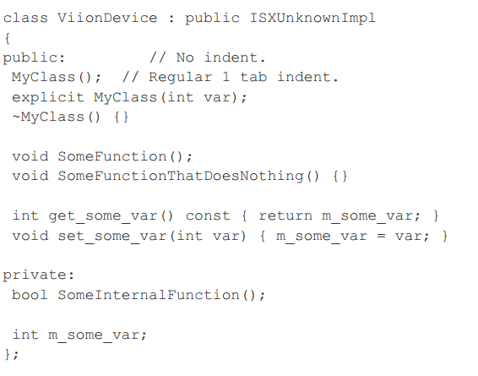

Slide 42
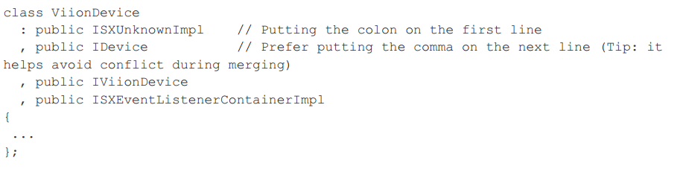
If a class has few base classes, prefers to use subsequent lines indented 2 tabs

Slide 43
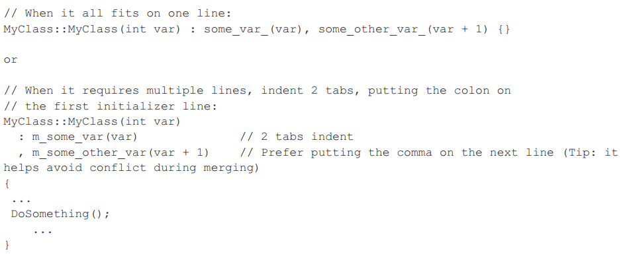
Constructor Initializer Lists
Constructor initializer lists can be all on one line or with subsequent lines indented four spaces.
There are two acceptable formats for initializer lists.

Slide 44
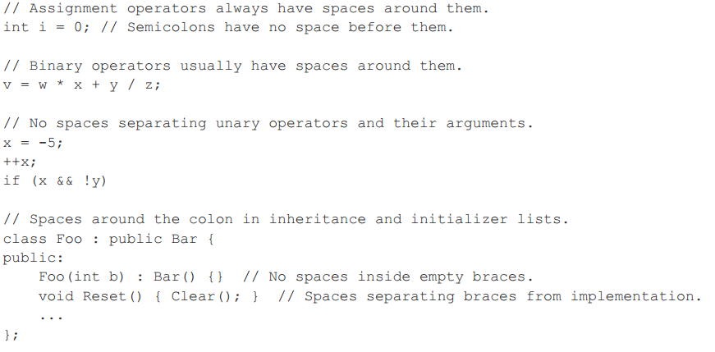
Horizontal Whitespace

Slide 45
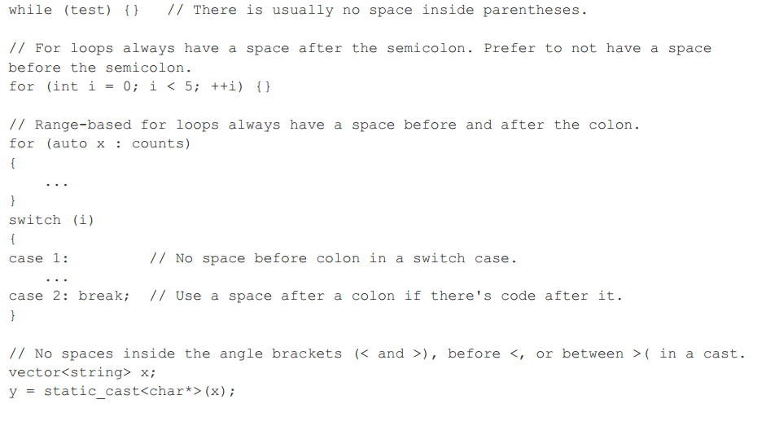

Slide 46
Vertical Whitespace
Minimize use of vertical whitespace.

Slide 47
Comments
Don’t comment on facts that can be derived quickly from the code itself.

Slide 48
File Comments
There is not mandatory file comments

Slide 49
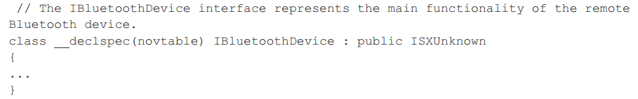
Class Comments
External interfaces definition should have an accompanying comment that describes what it is for.
However class comment is not mandatory for leaf or inner classes that are used only within the module.
Prefer "self-documenting" function name instead of comments for inner classes in the module.

Slide 50
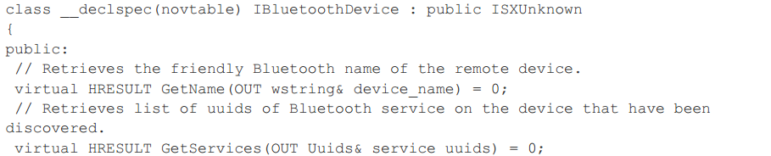
Function Comments
Every function declaration in external interfaces should have comments immediately preceding it that describe what the function does and how to use it.
In external interfaces prefer to use IN OUT macros before parameters to describe type of arguments.
Comments for function are not mandatory for leaf of inner classes that used only within the module.
Prefer "self-documenting" function name instead of comments. A good name is better than a good comment because it will be seen everywhere the function is used

Slide 51
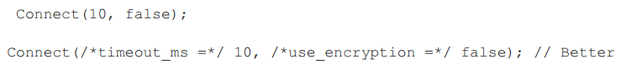
Implementation Comments
Do not comment a function in .cpp file if it's already documented in header file. It's redundancy.
Use an inline comment to comment “Named Function Parameter”

Slide 52
THANK YOU FOR ATTENTION.

